Slide 1

Concealed Carry Online Portal

Slide 2
Documents you will need to upload
Civilian Initial application to include:
Authorization to obtain health information with witness signature
Authorization for release of information complete with notary
Copy of your valid New Mexico Drivers License or Identification card
Copy of Birth Certificate or other required legal documents (not required if NMDL is Real ID)
Training Certificate from a DPS approved instructor
Idemia fingerprint receipt TCN (This is not the registration ID number that you get when you first register)
$100 fee payable online. If choosing to pay with check, please pay at our office to reduce delays
Civilian Renewal application to include:
Copy of valid New Mexico Driver’s License or Identification Card
Training Certificate w/ DPS-Approved Instructor
$75 fee payable online. If paying with check, please pay at our office to reduce delays

Slide 3
Documents you will need to upload
Active Military Initial application to include:
Authorization to obtain health information with witness signature
Authorization for release of information complete with notary
Copy of your valid New Mexico Drivers License or Identification card
One (1) passport photo if your Driver’s License is not issued in New Mexico
Copy of Birth Certificate or other required legal documents (not required if NMDL is Real ID)
Copy of Military ID and PCS (Permanent Change of Station) Orders
Idemia fingerprint receipt TCN (This is not the Registration ID number) $23.00
No fees are paid to the State for military applications
Active Military Renewal application to include:
Copy of valid New Mexico Driver’s License or Identification Card
Copy of Military ID or PCS (Permanent Change of Station) Orders
No fees are paid to the State for military applications

Slide 4
Documents you will need to upload
Retired Military and Military Veteran Initial application to include:
Authorization to obtain health information with witness signature
Authorization for release of information complete with notary
DD-214 with character of discharge (must have Honorable Discharge)
Copy of your valid New Mexico Drivers License or Identification card
Copy of Birth Certificate or other required legal documents (not required if NMDL is Real ID)
Idemia fingerprint receipt TCN (This is not the registration ID that you get when you first register)
Training Certificate w/ DPS-Approved Instructor *if outside of 20 years of separation
No fees paid to the State for military applications
Retired military and Military Veteran Renewal application to include:
Copy of valid New Mexico Driver’s License or Identification Card
DD-214 with character of discharge (must have Honorable Discharge)
Training Certificate w/ DPS-Approved Instructor *if outside of 20 years of separation
No fees paid to the State for military applications

Slide 5
Documents you will need to upload
Active Law Enforcement Initial application to include:
Authorization to obtain health information with witness signature
Authorization for release of information complete with notary
Copy of your valid New Mexico Drivers License or Identification card
Copy of Birth Certificate or other required legal documents (not required if NMDL is Real ID)
Gemalto fingerprint receipt TCN (This is not the registration ID that you get when you first register)
Agency ID
Certification Number
Letter of Good Standing
Copy of last qualification
No fees paid to the State for Law Enforcement applications
Active law Enforcement Renewal application to include:
Copy of valid New Mexico Driver’s License or Identification Card
Agency ID
Certification Number
Letter of Good Standing
No fees paid to the State for Law Enforcement applications

Slide 6
Documents you will need to upload
Retired Law Enforcement Initial application to include:
Authorization to obtain health information with witness signature
Authorization for release of information complete with notary
Copy of your valid New Mexico Drivers License or Identification card
Copy of Birth Certificate or other required legal documents (not required if NMDL is a Real ID)
Gemalto fingerprint receipt TCN (This is not the registration ID that you get when you first register)
Letter of Good Standing with agency ID and certification number
Copy of last qualification or training certificate from DPS approved instructor (if outside of 10 years)
No fees are paid to the State for Law Enforcement applications
Retired Law Enforcement Renewal application to include:
Copy of valid New Mexico Driver’s License or Identification Card
Agency ID
Certification Number
Letter of Good Standing
Copy of last qualification or training certificate from DPS approved instructor (if outside of 10 years)
No fees are paid to the State for Law Enforcement applications

Slide 7
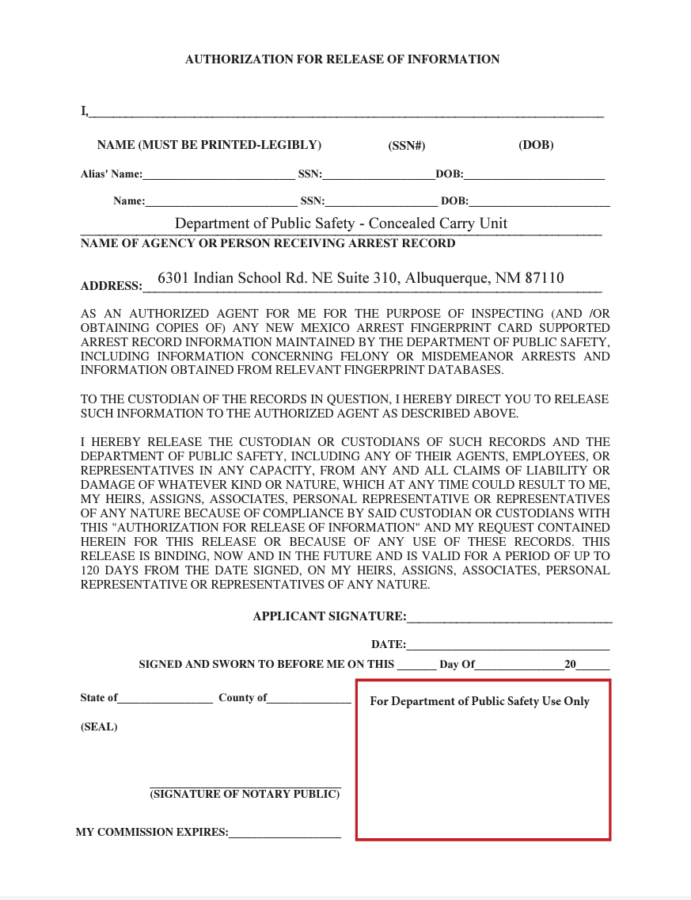
Examples of Documents
Authorization for Release of Information Form
(form must be notarized)
Type or print your name, social security number, and date of birth on top line
Sign and date with notary present
Notary services are no longer available at the Concealed Carry Unit office

Slide 8
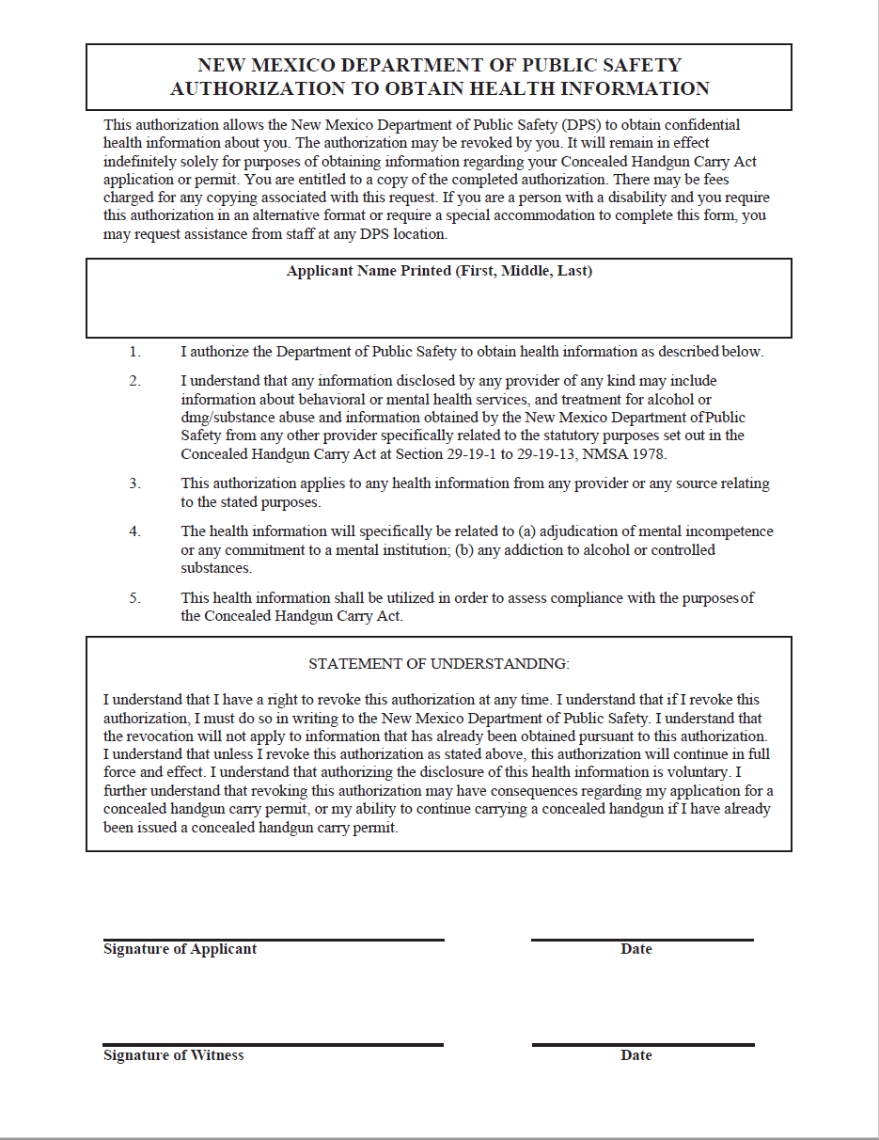
Examples of Documents
Authorization to Obtain Health Information Form
Type or print your name
Your signature
Dates of signatures must match
Signature of witness
(Anyone over the age of 18)

Slide 9
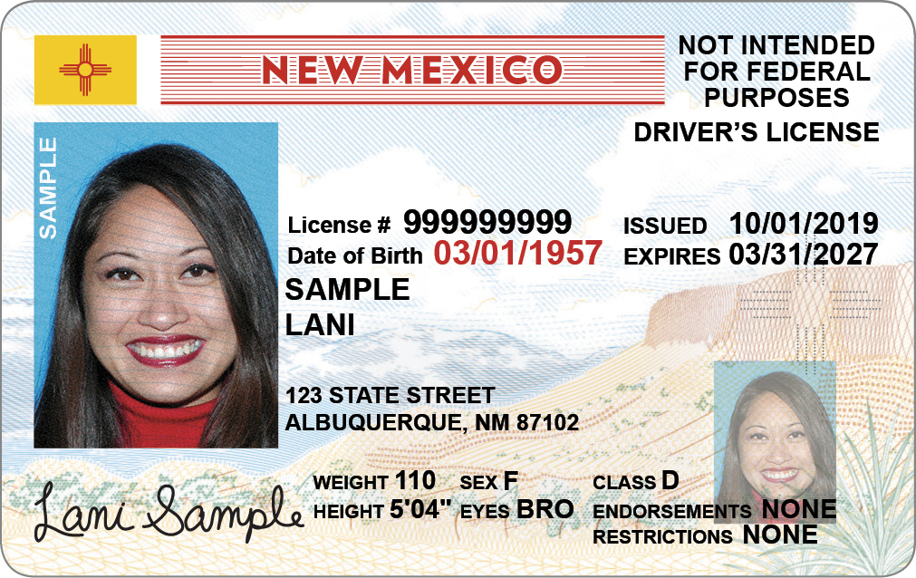
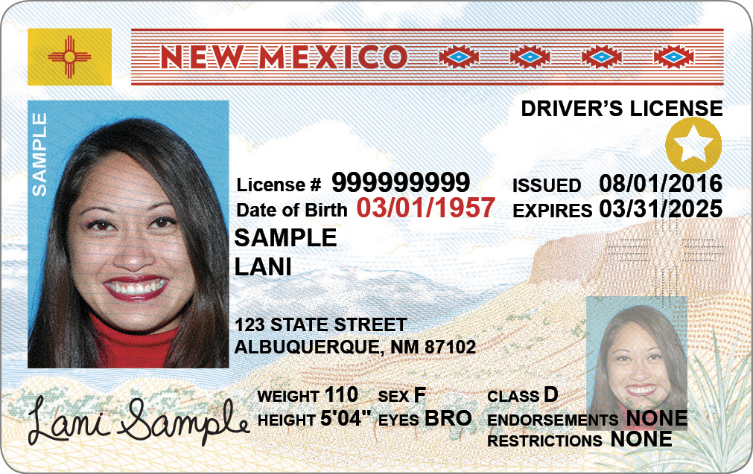
Examples of Documents
NM Current Driver’s License and ID Card Examples
Standard
License
Real ID with
Gold Star

Slide 10
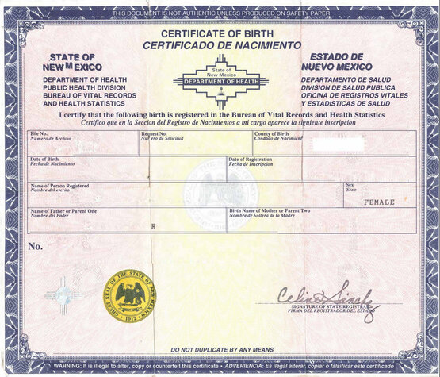
Examples of Documents
Birth Certificate and Permanent Resident Card

Slide 11
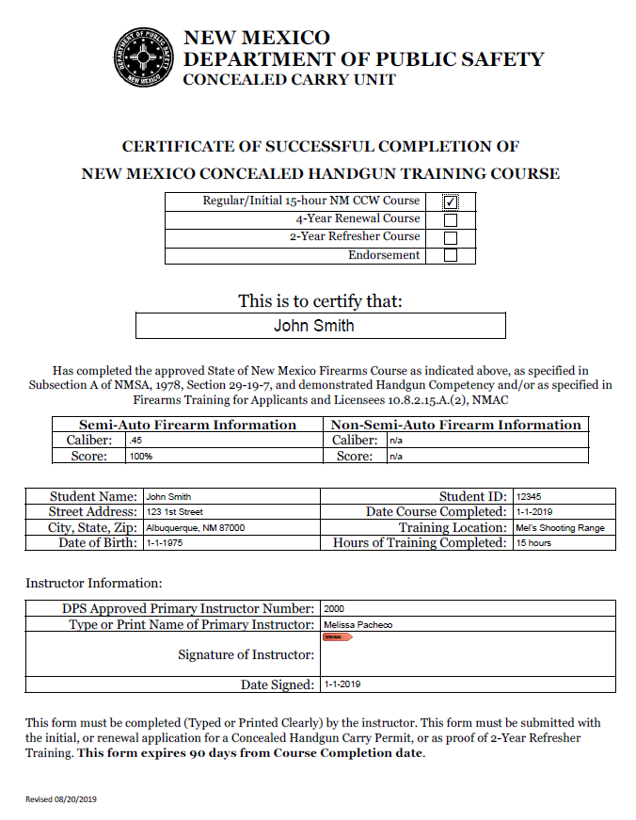
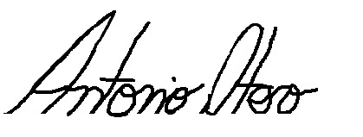
Examples of Documents
Training Certificate
Verify all your information is correct
330
Antonio Otero
Must be signed by instructor

Slide 12
Examples of Documents
Non-civilian additional documents
Veterans:
MUST submit DD-214 with character of discharge section (member-4)
MUST have Honorable Discharge – no other type qualifies
Other forms accepted are:
Letter from VA stating Honorable Discharge, or certificate showing Honorable Discharge
Not accepted forms:
Veteran on NMDL or VA card

Slide 13
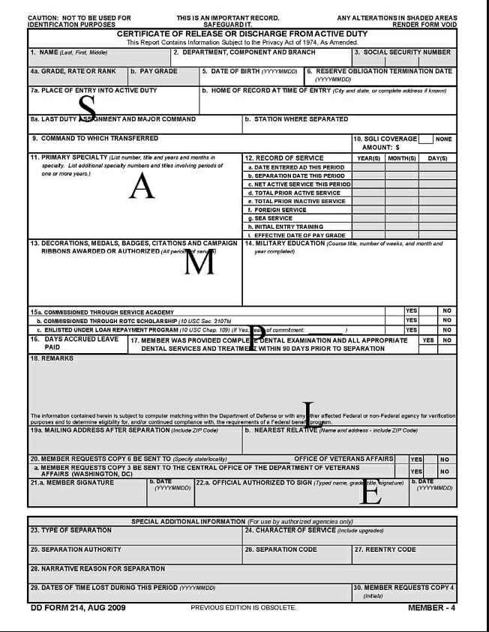
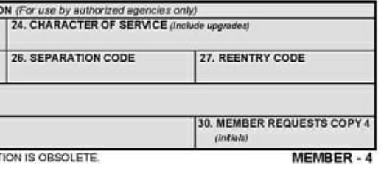




Examples of Documents
Non-civilian additional documents
Must have character of service as “Honorable”
Usually located on member -4

Slide 14
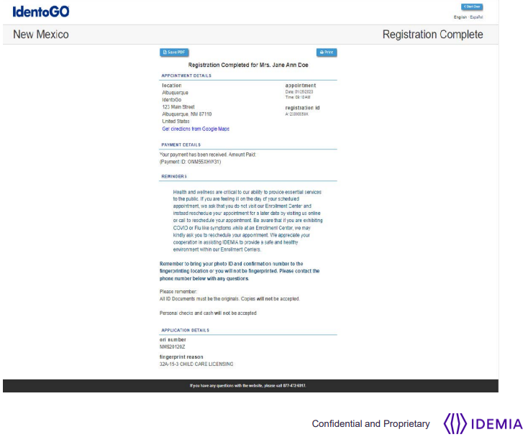

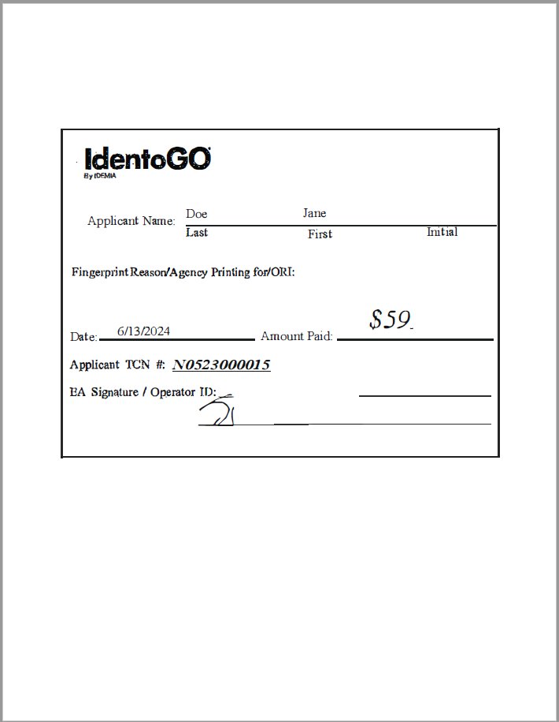
Examples of Documents
Idemia (IdentoGo) Fingerprint Receipt must include the TCN
(Transaction confirmation number “TCN”)
Form with only registration number is not the fingerprint receipt
Form with TCN is the fingerprint receipt
Actual TCN receipt form supplied by vendor may vary in appearance

Slide 15
Examples of Documents
You cannot use fingerprints taken for other purposes such as employment or security clearance
Fingerprints assigned for the Concealed Carry Unit must have an Originating Agency Identification number “ORI” of :
NM920200Z for civilian $59
NM920272Z for military or law enforcement $23.00

Slide 16
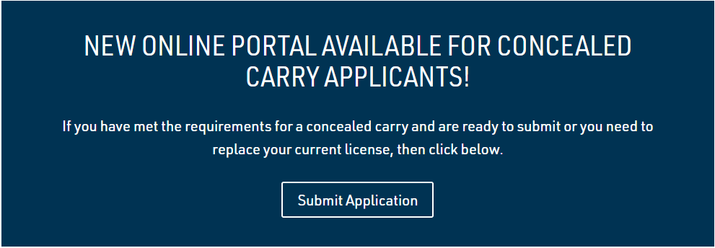
Where to find the online portal?
You can find the link by going to the CCW page of the New Mexico Department of Public Safety Website
https://www.dps.nm.gov/law-enforcement-records-bureau/concealed-carry-licenses/

Slide 17
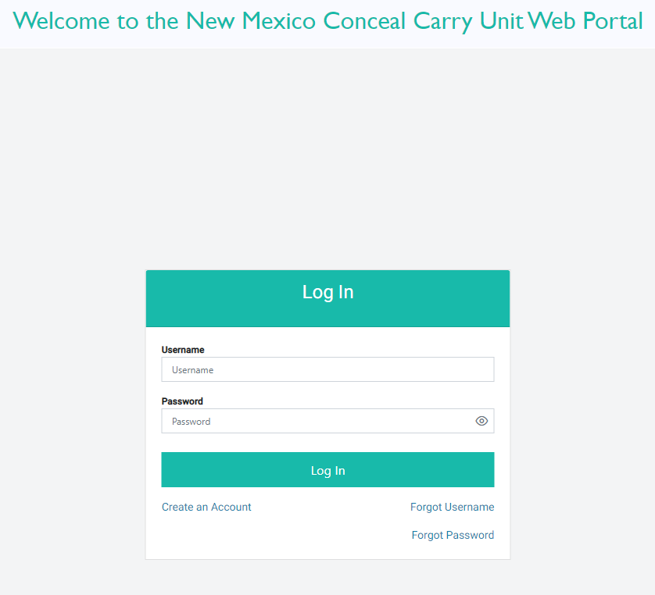
Where to find the online portal?
You can also use this direct link to take you to the online portal
https://ccu.dps.nm.gov/ccu-app/login

Slide 18
Creating Your Account
The first step will be to create an account
Click the “Create account” link

Slide 19
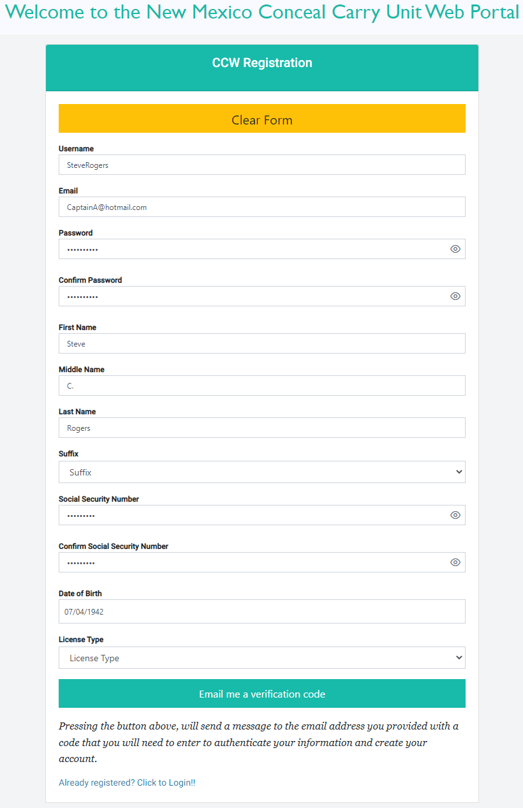
Creating Your Account
Fill out all the fields on the form
Your password must contain:
      at least one upper case
      at least one lower case
      at least one digit (0..9)
      should contain at least one Special character (!@#\$&*~)
      must be at least 8 characters in length
      Make sure to select the license type that applies to you
      The license type will determine what documents you need to upload (civilian, military, etc.)
      An email verification code will be sent to the email provided

Slide 20
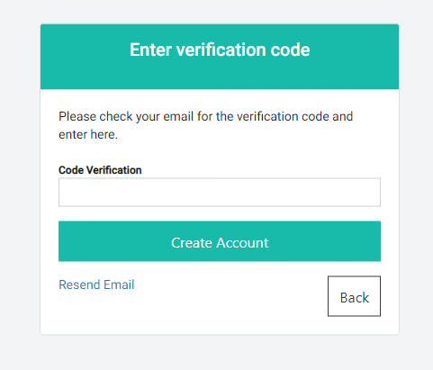
Creating Your Account
Enter verification code from email

Slide 21
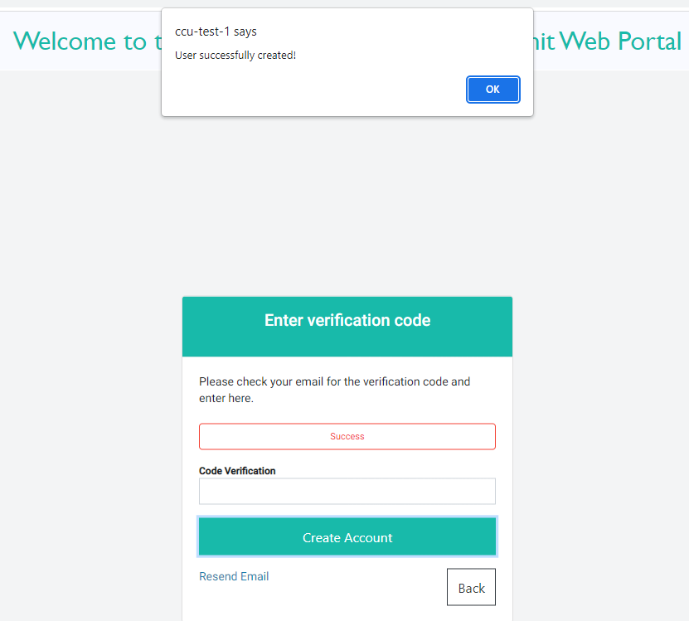
Creating Your Account
User has been successfully created
Click blue “OK” box to proceed

Slide 22
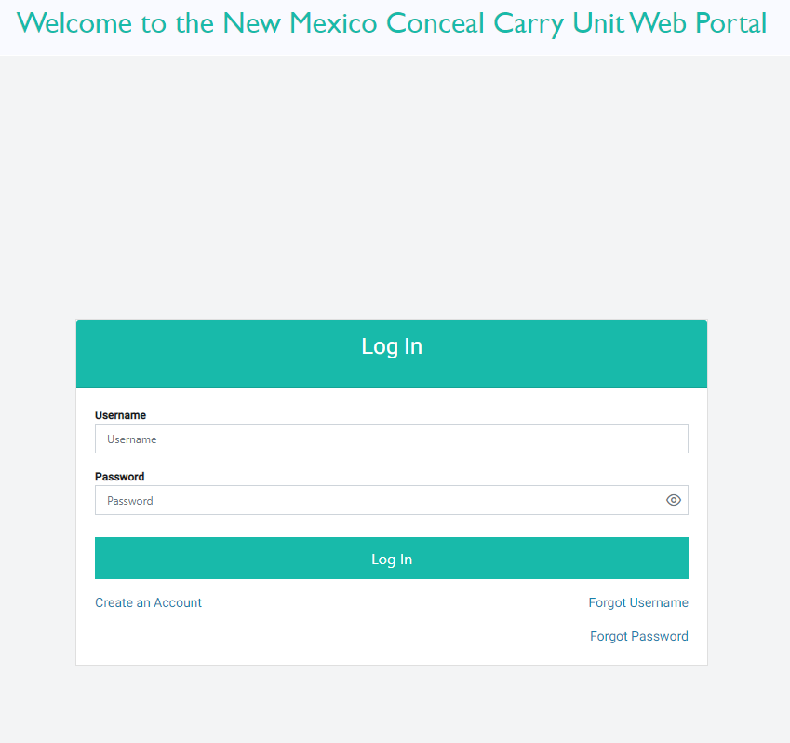
Submitting Your Application
Log into your account with the username and password you just created

Slide 23
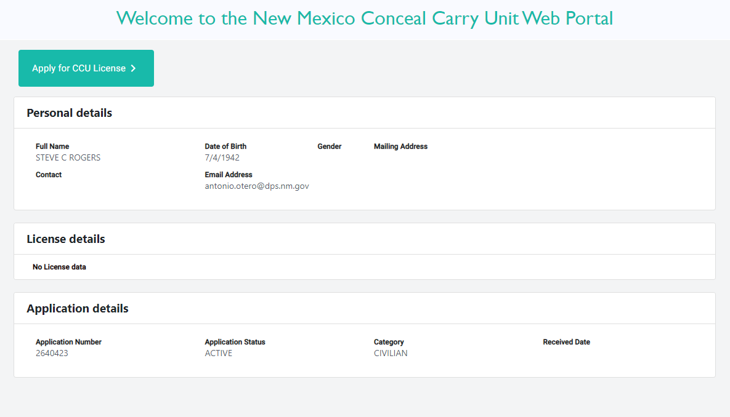
Submitting Your Application
Once you login you will select the green “Apply for CCU License”

Slide 24
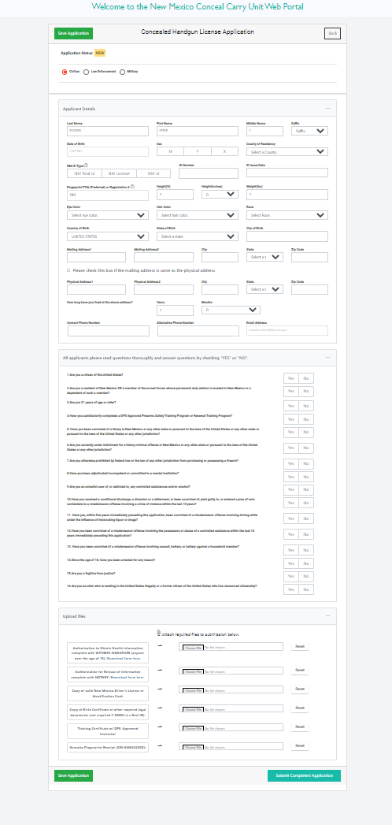
Submitting Your Application
Select and verify applicant type
Fill in the details and answer questionnaire
Don’t forget to upload documents
Only upload documents that were requested
Any missing or incorrect documentation will result in delays

Slide 25
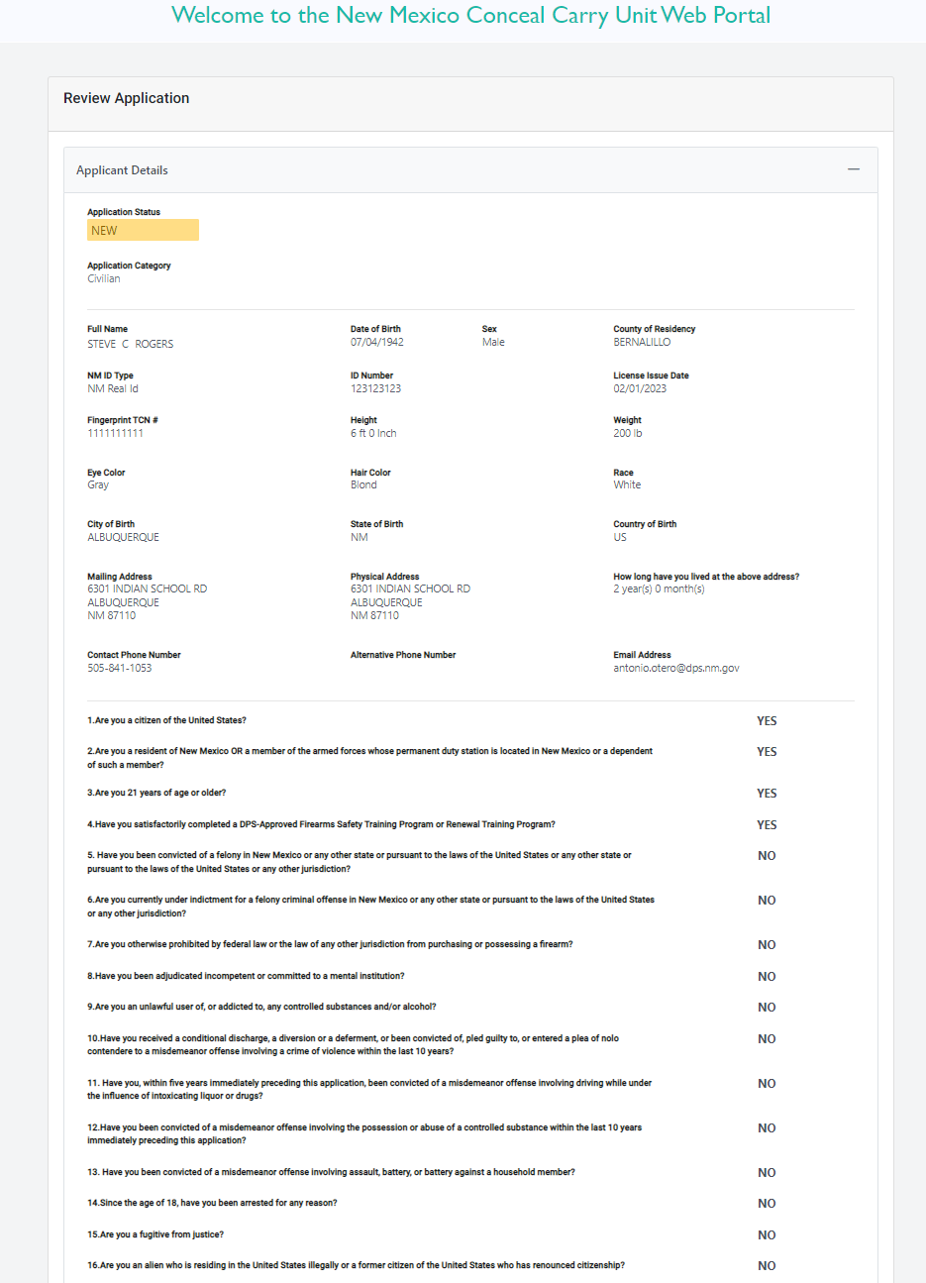
Submitting Your Application
Verify information on application

Slide 26
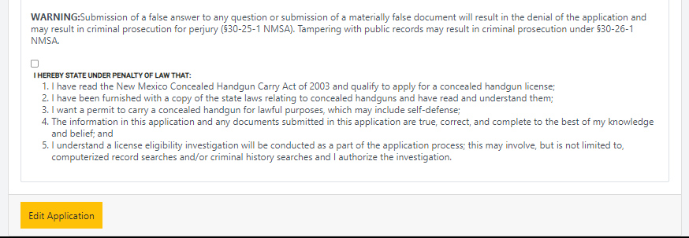
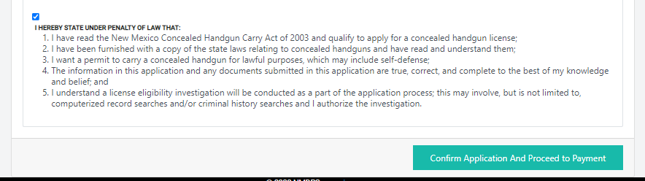
Submitting Your Application
Acknowledge the penalty of law by checking box
Confirm application and proceed to payment

Slide 27
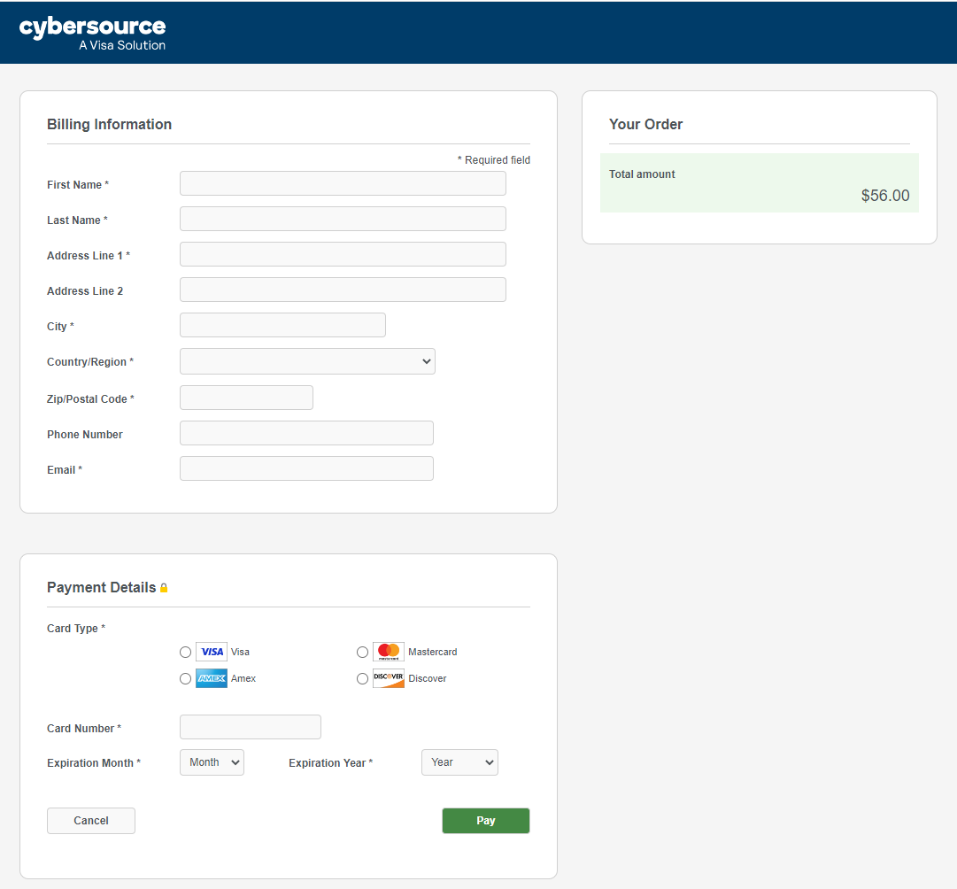
Submitting Your Application
You will be directed to the payment screen
$100

Slide 28
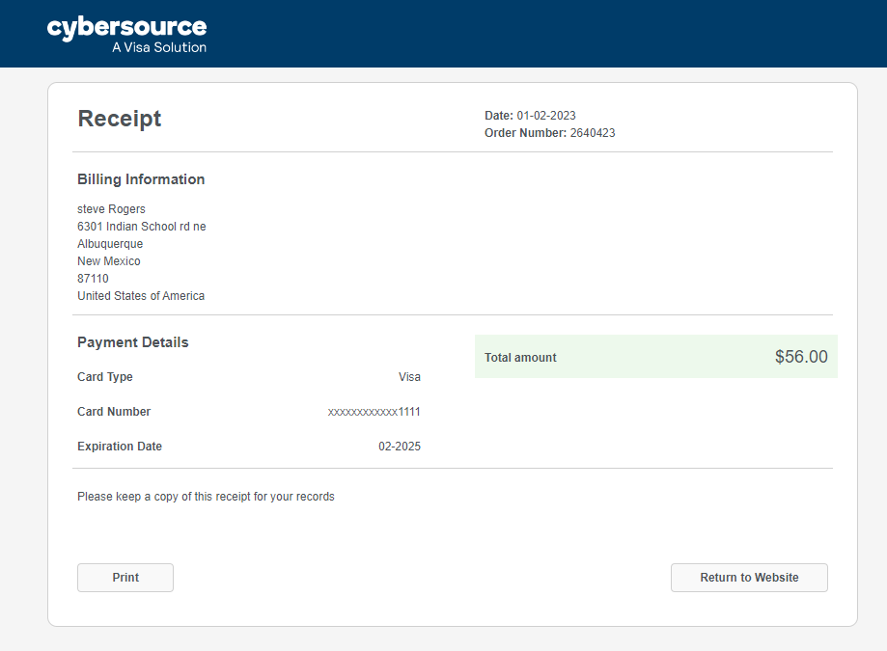
Submitting Your Application
Congratulations!
Your application has been submitted
$100
If you would like to check your application status
You can return to website
You can print your receipt

Slide 29
Concealed Carry Unit Contact Information
Concealed Handgun Carry Unit
6301 Indian School Rd NE Suite 310
Albuquerque, NM 87110
(505) 841-8053
NMCC.questions@dps.nm.gov

